Slide 1
Job Salary Prediction
a theoretical study to predict job salaries based on job descriptions

Slide 2
Group Members
SADMAN SHAWMIK Section 03 — 15301036
LAMIA TASNIM Section 02 — 13301121
SHINY RAISA Section 03 — 15301047

Slide 3
Introduction
Since the job market is very competitive, we want to build a prediction engine that can spit out salaries based on different criteria like company, location, position, etc. The prediction model will be able to:
Greatly improve job seekers’ search experience
Assist employers and job seekers in estimating the optimal market worth of different positions
Make the job search more effective & transparent
Goal: To predict job salary using supervised algorithm
Dataset: Job description data from UK-based job site

Slide 4
Dataset
The main dataset would consist of a large number of rows representing individual job ads, and a series of fields about each job ad. The columns are as follows: Id, title, full description, locationRaw, LocationNormalized, contractType, ContractTime, company, Category, SalaryRaw, SalaryNormalized, and SourceName
Location Tree —This is a supplemental data set that describes the hierarchical relationship between the different normalized locations shown in the job data
ID | TITLE | FULL DESCRIPTION | LOCATION RAW | LOCATION NORMALIZED | CONTRACT TYPE | CONTRACT TIME | COMPANY | CATEGORY | SALARY RAW | SALARY NORMALIZED | SOURCE NAME
12612628 | Engineering Systems Analyst | Engineering Systems Analyst … Salary ****K | Dorking, Surrey, Surrey | Dorking |  | Permanent | Gregory Martin International | Engineering Jobs | 20000 - 30000/annum 20-30K | 25000 | cv-library.co.uk
12612830 | Stress Engineer Glasgow | Stress Engineer Glasgow Salary … Glasgow Salary **** to **** | Glasgow, Scotland, Scotland | Glasgow |  | Permanent | Gregory Martin International | Engineering Jobs | 25000 - 35000/annum 25-35K | 30000 | cv-library.co.uk

Slide 5
Methodology
Data collection — dataset acquired from a Kaggle competition
Equipments
Development language: Python 3.6.3
Integrated Development Environment: Anaconda Navigator
Libraries and packages: NumPy, Pandas, Scikit-learn, pickle, features

Slide 6
Methodology (cont.)
Algorithm: Random Forest — supervised algorithm
Data manipulation: read dataset -> fit data using final estimator -> save classifier to file
Prediction: the predict.py file is run, which loads the classifier, makes the predictions for each job ID, and writes the SalaryNormalized column to a file.

Slide 7
Program
Program files:
data — read dataset & write output to file
features — clean the dataset & pick the features to be used
train — train the model
predict — predict salaries based on test data
Lab content used in the project — pandas, sklearn, numpy

Slide 8
Algorithm
Random Forest — a supervised algorithm
Why?
Can be used for both classification & regression tasks
Can handle missing values
sklearn.ensemble.RandomForestRegressor

Slide 9
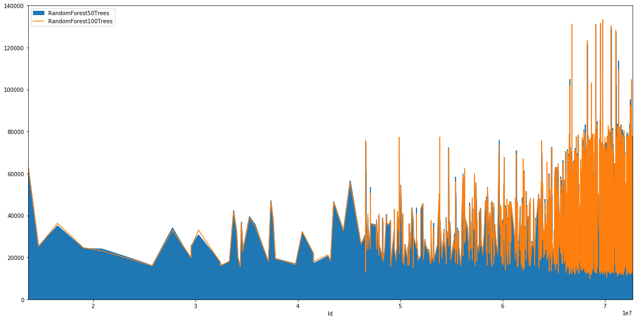
Results
Fig. 1. Result comparison between 50 trees and 100 trees

Slide 10
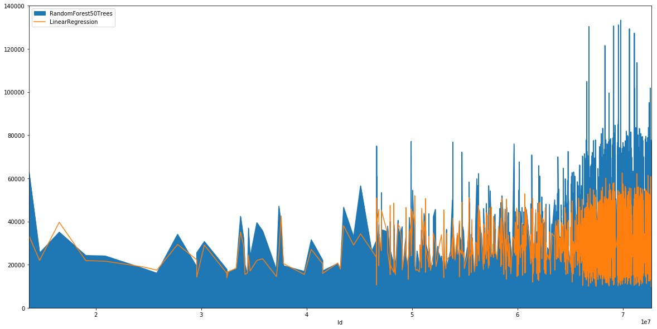
Results (cont.)
Fig. 1. Result comparison between 50 trees and 100 trees

Slide 11
Conclusion
Described our iteration of Job Salary Prediction using the dataset from a Kaggle-hosted competition
This prediction engine can successfully generate a normalized predicted salary based on different criteria from job ads
Demonstrated the effect on results using twice the number of trees to generate the forest
Further plans include turning this project into a full-fledged web app by integrating the engine with Django

Slide 12
Acknowledgement
We would like to thank Dr. Iftekharul Mobin, Assistant Professor and Dr. Mohammad Zavid Parvez, Assistant Professor at the Department of Computer Science and Engineering, BRAC University, for their continuous support, guidance, and thoughtful feedback throughout the development lifecycle of this project.

Slide 13
Thank you

